Slide 1
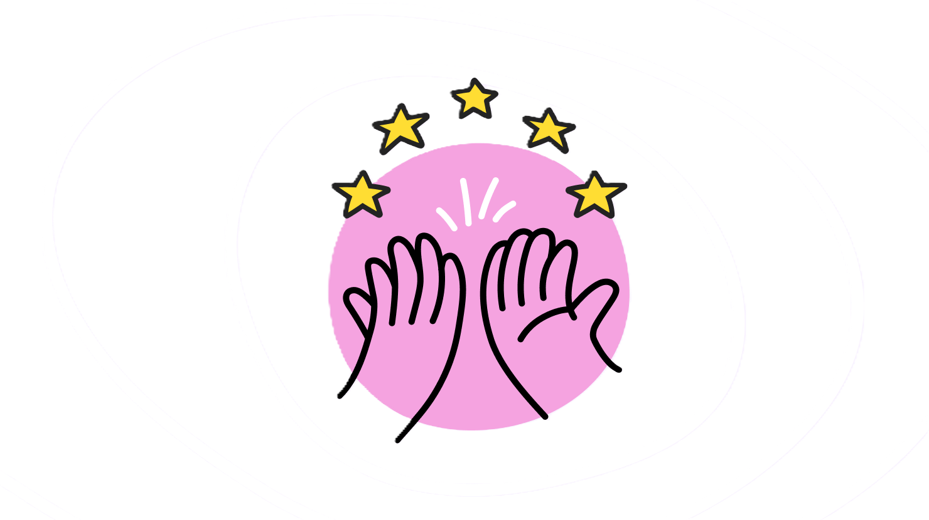
Quantum ring all-reduce
María Gragera Garcés & Lirandë Pira
Hackamonth 2026
QUANTUM
COMMUNICATION
LEARNING

Slide 2
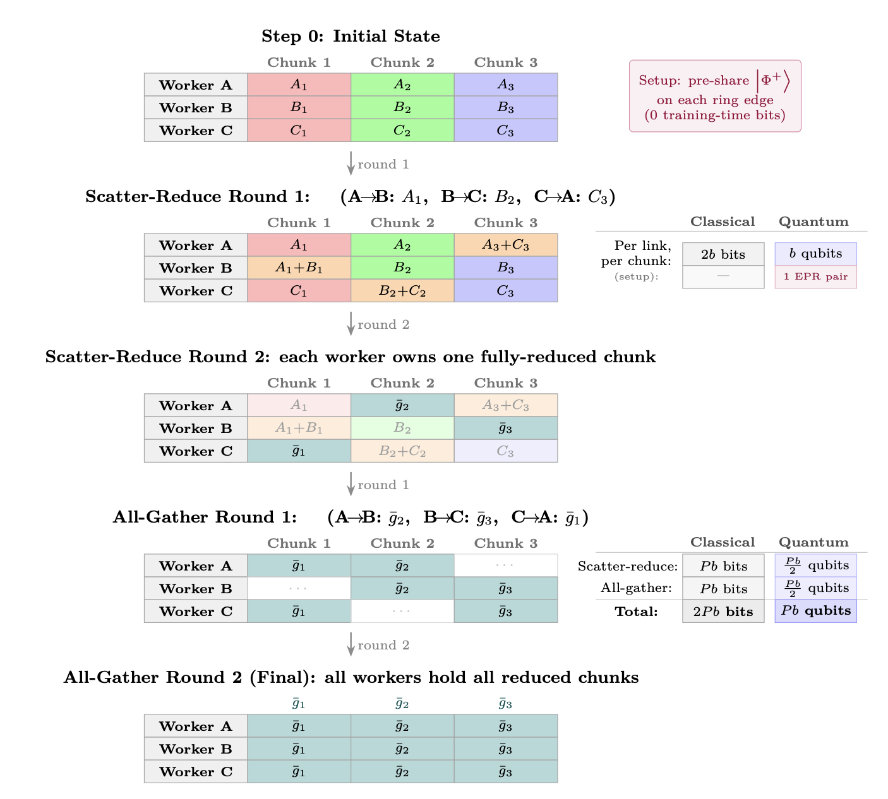

Slide 3
Ring all reduce
Ring all-reduce is a foundational communication primitive for large-scale distributed training.
Used in models like
Horovod
PyTorch DDP
NCCL (NVIDIA Collective Communications Library).

Slide 4
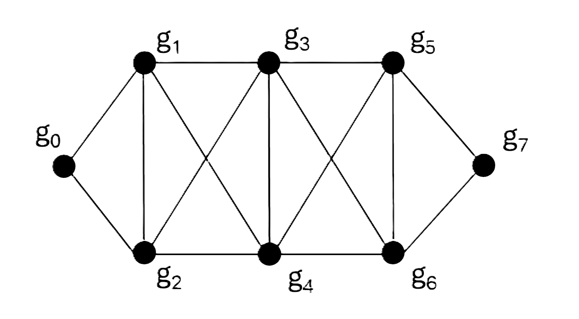
Ring all reduce
OBJECTIVE
Synchronize model weights across multiple GPUs as fast as possible with minimal communication delays

Slide 5
Ring all reduce
WHY
The full model is too large to share in one coordinated round, so we need to play around the bandwidth constraints.

Slide 6
Ring all reduce
END STATE
All devices share one consistent model.

Slide 7
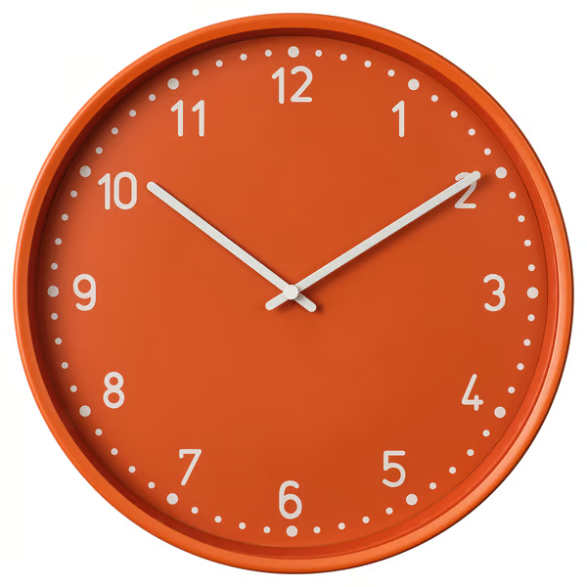
Ring all reduce
END STATE
All devices share one consistent model.
TRAINING TIME

Slide 8
Ring all reduce
B
END STATE
All devices share one consistent model.
A
C
COORDINATION TIME
F
D
E

Slide 9
Ring all reduce
B
END STATE
All devices share one consistent model.
A
C
A
B
COORDINATION TIME
F
D
E

Slide 10
Ring all reduce
B
END STATE
All devices share one consistent model.
A
C
g₀^{A}
A
B
COORDINATION TIME
F
D
E

Slide 11
Ring all reduce
B
END STATE
All devices share one consistent model.
A
C
g₀^{A}
A
B
COORDINATION TIME
F
D
E

Slide 12
Ring all reduce
B
END STATE
All devices share one consistent model.
A
C
A
B
COORDINATION TIME
g₀^{A} + g₀^{B}
F
D
E

Slide 13
Ring all reduce
B
END STATE
All devices share one consistent model.
F
A
C
g₀^{FINAL} = < g₀^{A} + g₀^{B} + g₀^{C} + g₀^{D} + g₀E + g₀^{F} >
COORDINATION TIME
F
D
E

Slide 14
Ring all reduce
g₀^{A}
g₁^{B}
B
END STATE
All devices share one consistent model.
A
C
COORDINATION TIME
g₂^{C}
F
D
E

Slide 15
Ring all reduce
g₅^{FINAL}
B
END STATE
All devices share one consistent model.
A
g₆^{FINAL}
C
COORDINATION TIME
g₄^{FINAL}
F
g₃^{FINAL}
g₀^{FINAL} & g₇^{FINAL}
D
E
g₁^{FINAL} & g₂^{FINAL}

Slide 16
Ring all reduce
LAST STEP
B
END STATE
All devices share one consistent model.
A
C
COORDINATION TIME
F
D
E

Slide 17
Ring all reduce
Complexity
2(N−1) communication rounds
N = number of devices
scatter-reduce (N−1)
all-gather (N−1)

Slide 18
WHAT WOULD A QUANTUM VERSION LOOK LIKE?

Slide 19
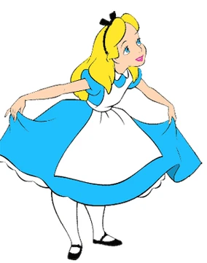
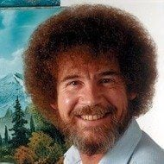
Superdense encoding
THEY WANT TO SHARE 2 BITS WORTH OF INFO

Slide 20
Superdense encoding
THEY WANT TO SHARE 2 BITS WORTH OF INFO
In the classical world
Alice sends two bits

Slide 21

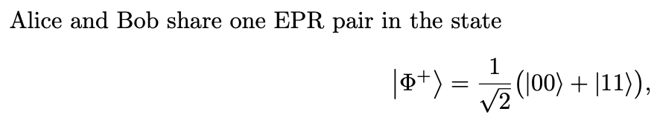
Superdense encoding
THEY WANT TO SHARE 2 BITS WORTH OF INFO
BUT IN THE QUANTUM WORLD
PRE-PROCESSING

Slide 22
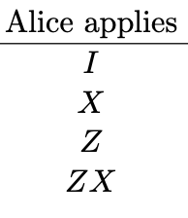
Superdense encoding
THEY WANT TO SHARE 2 BITS WORTH OF INFO
IN THE QUANTUM WORLD
PRE-PROCESSING

Slide 23
Superdense encoding
THEY WANT TO SHARE 2 BITS WORTH OF INFO
IN THE QUANTUM WORLD
COMMUNICATION
Alice sends her qubit

Slide 24
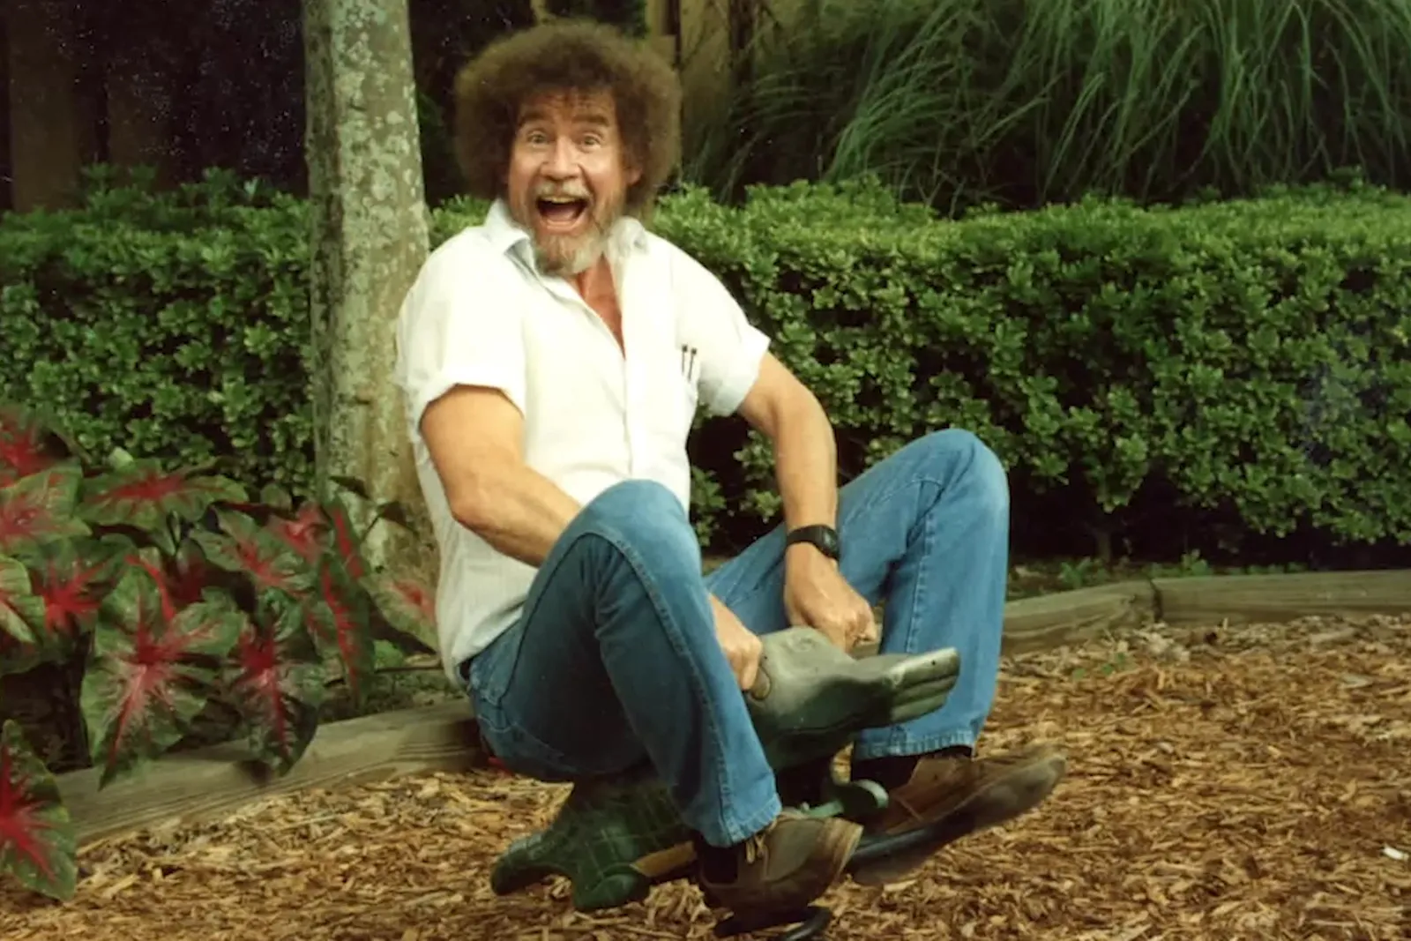
Superdense encoding
THEY WANT TO SHARE 2 BITS WORTH OF INFO
IN THE QUANTUM WORLD
Bob measures
& holds two bits!
2 BITS = 1 QUBITS
0 | 1

Slide 25
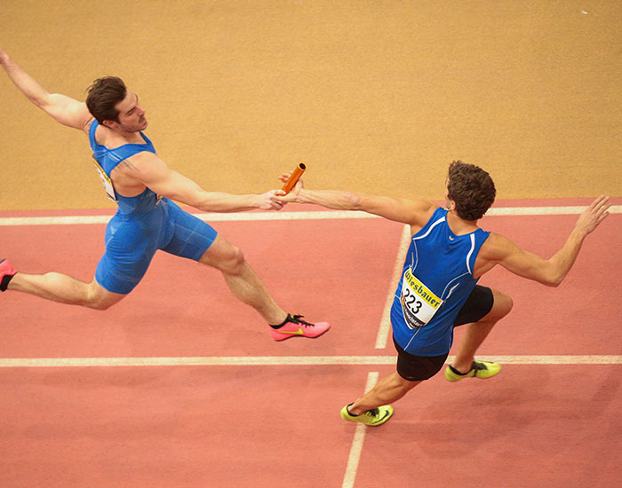
Quantum Ring all reduce
Complexity
2P bits → P qubits
EPR version = a relay race

Slide 26

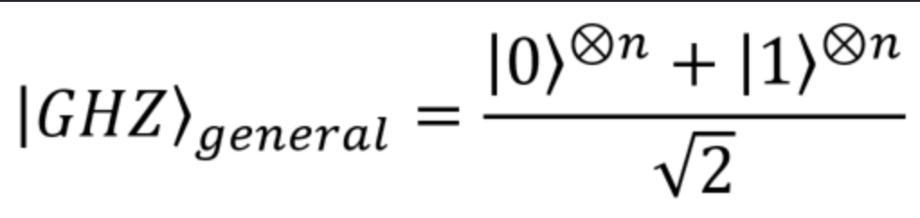
SMART Quantum Ring all reduce
GHZ version = one shared canvas

Slide 27
SMART Quantum Ring all reduce
GHZ state shared (pre-processing during training)
Each device writes its gradient into its own qubit as a local phase rotation
Each device measures its qubit and broadcasts its 1-bit outcome
Everyone XORs the broadcast bits to read off the aggregate
SAME COMPLEXITY AS THE SUPERDENSE ENCODING

Slide 28
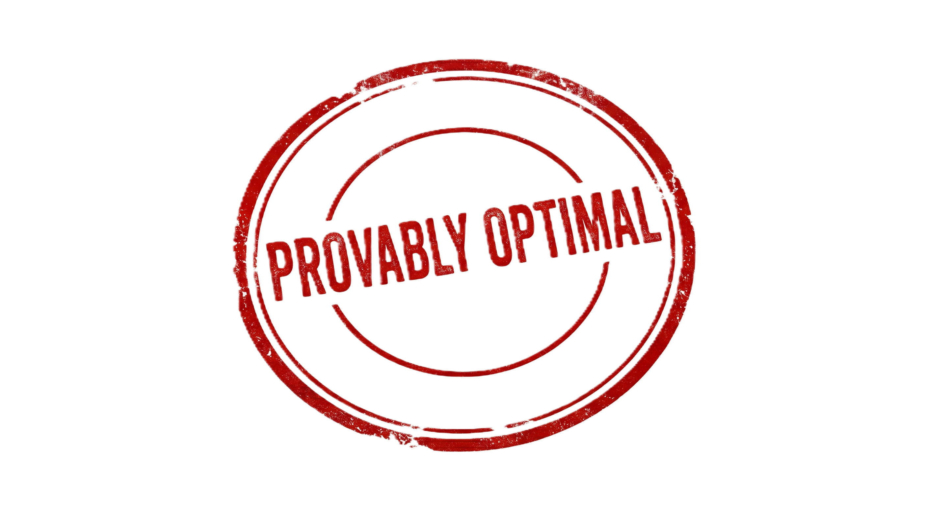

SMART Quantum Ring all reduce
GHZ state shared (pre-processing during training)
Each device writes its gradient into its own qubit as a local phase rotation
Each device measures its qubit and broadcasts its 1-bit outcome
Everyone XORs the broadcast bits to read off the aggregate
SAME COMPLEXITY AS THE SUPERDENSE ENCODING

Slide 29
SMART Quantum Ring all reduce
GHZ is the best quantum state for estimating a linear sum:
it maximizes the Fisher information.
The shared state is set up before any gradient is encoded, you can verify it independently of the data:
the phase encoding only ever exposes the global sum, never any individual gradient.

Slide 30

… but where is the exponential advantage?

Slide 31
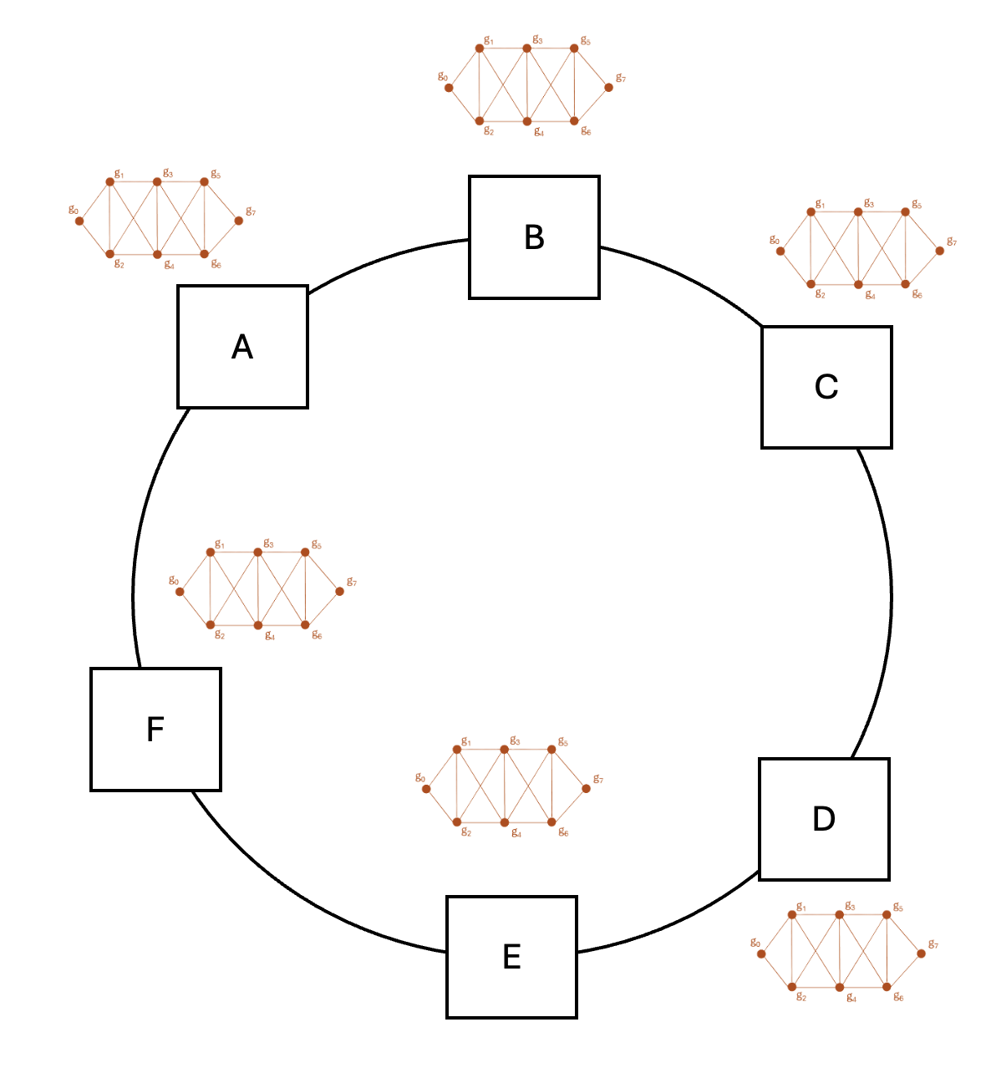

Aggregation problems
Bandwidth constraints still exist!

Slide 32
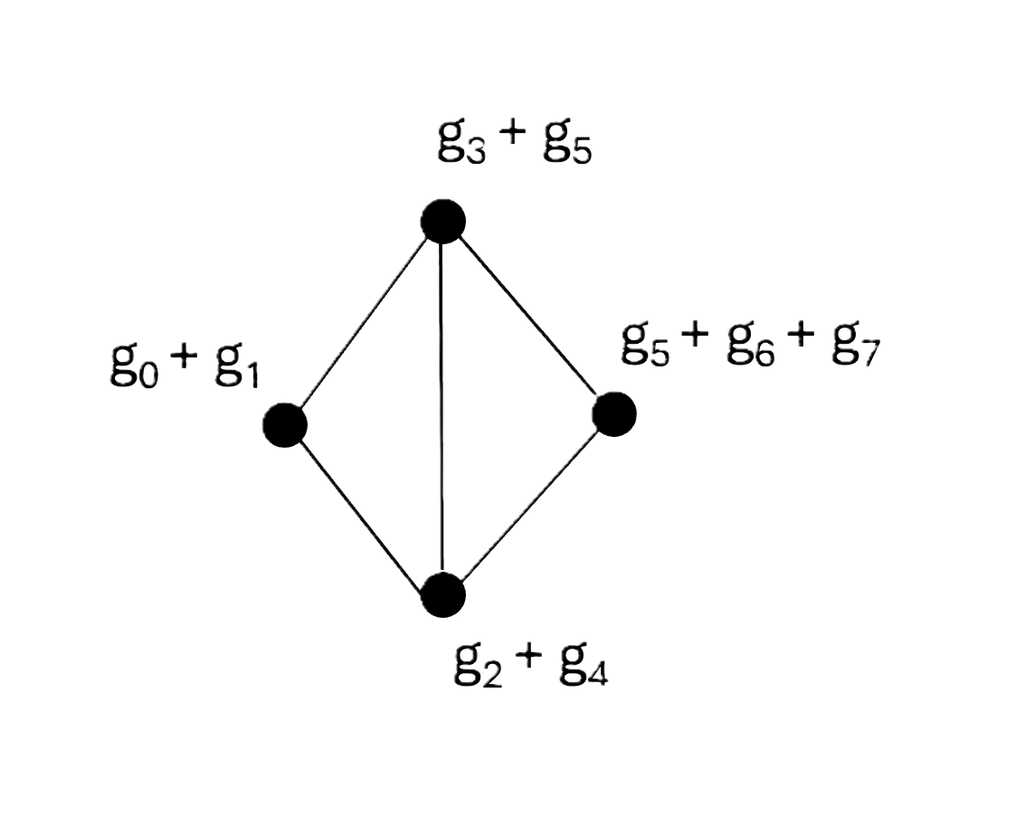
Aggregation problems
Compress our model

Slide 33

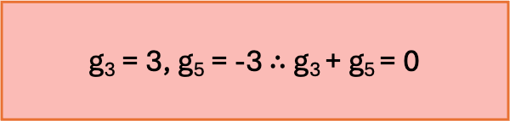
Aggregation problems
Compress our model
g₃ = 3, g₅ = -3 $∴$ g₃ + g₅ = 0

Slide 34
Aggregation problems
Can I send accurate and correct information?
Given my knowledge of the model, is the relation I care about TRUE?
Compress our model
g₃ = 3, g₅ = -3 $∴$ g₃ + g₅ = 0

Slide 35
Aggregation problems
Can I send accurate and correct information?
Given my knowledge of the model, is the relation I care about TRUE?
Compress our model
LET’S PLAY SOME GAMES
g₃ = 3, g₅ = -3 $∴$ g₃ + g₅ = 0

Slide 36
Margin conflict detection
Can I send accurate and correct information?
Are our gradients pulling together or cancelling?
A
B

Slide 37
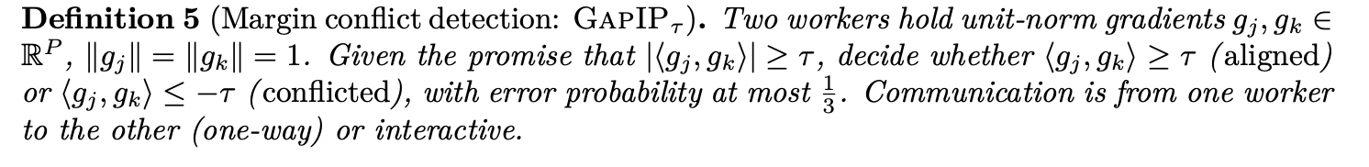
Margin conflict detection
Can our two gradients be safely merged, or will averaging them cancel the signal?
g_{x}^{A}
g_{x}^{B}
A
B

Slide 38
Margin conflict detection
CLASSICAL
g_{x}^{A}
A
B
Has to make some decision about:
g_{x}^{A} & g_{x}^{B}

Slide 39
Margin conflict detection
CLASSICAL
g_{x}^{A}
Bandwidth constraints still exist!
A
B
Has to make some decision about:
g_{x}^{A} & g_{x}^{B}

Slide 40
Margin conflict detection
CLASSICAL
g_{x}^{A}
Bandwidth constraints still exist!
compressed sketch size is ~1/τ²
A
B
Has to make some decision about:
g_{x}^{A} & g_{x}^{B}
Why 1/τ² ?
Sketching essentially means sampling:
error ≈ 1/√n. Want error ≤ τ?
Then 1/√n ≤ τ → √n ≥ 1/τ → n ≥ 1/τ².

Slide 41

Margin conflict detection
CLASSICAL
QUANTUM
compressed sketch size is ~1/τ²
A
B

Slide 42
Margin conflict detection
Can our two gradients be safely merged, or will averaging them cancel the signal?

Slide 43
Margin conflict detection
INPUT
Normalised gradients:
gA = (3, 4)
gB = (−6, 0)
A
B
length ‖gA‖ = √(3² + 4²) = √25 = 5
normalize: ûA = (3/5, 4/5) = (0.6, 0.8)
length ‖gB‖ = √(6² + 0²) = 6
normalize: ûB = (−6/6, 0/6) = (−1, 0)

Slide 44
Margin conflict detection
OUTPUT
Inner product normalised vectors:
(0.6, 0.8)
(−1, 0)
A
B
ûA · ûB = (0.6)(−1) + (0.8)(0) = −0.6
arccos(−0.6) ≈
127° > 90 °
CONFLICT

Slide 45
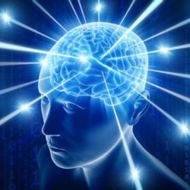
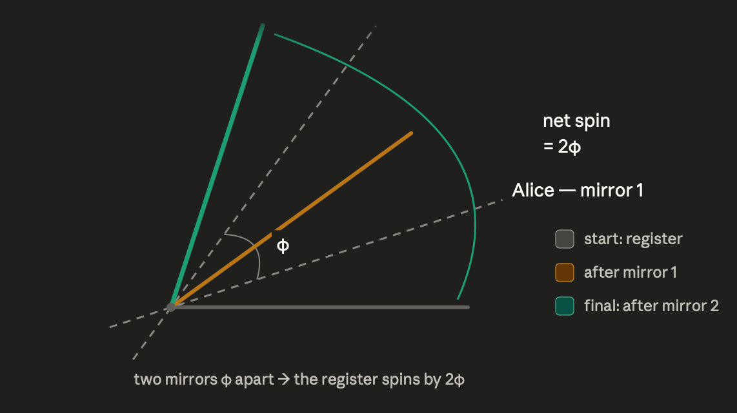
Margin conflict detection
Gap inner product + amplitude estimation
CLASSICAL
QUANTUM
compressed sketch size is ~1/τ²
Projections
A
B

Slide 46
Margin conflict detection
τ = the margin/precision on the angle
Quantum
1/τ round-trips
A
log P qubits
B
log P qubits
passes through reflections and accumulates a little more of the rotation
passes through reflections and accumulates a little more of the rotation

Slide 47
Margin conflict detection
τ = the margin/precision on the angle
CLASSICAL
QUANTUM
1/τ round-trips
compressed sketch size is ~1/τ²
A
B
A
log P qubits
B
log P qubits
Õ(1/τ²) bits
One way
Õ((1/τ)log(P)) qubits
Interactive
Notes:
Are these complexities correct? Do they show the amount of info we are sending?
Is quantum always worse in terms of time because of the rounds or could it be better because of the amount of info needing to be sent one way being stupid big compared to the two way?

Slide 48
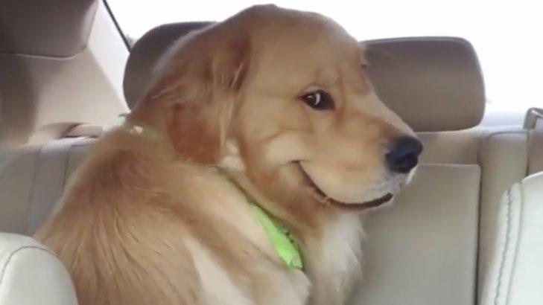
WHAT ABOUT EXPONENTIAL ADVANTAGE?

Slide 49
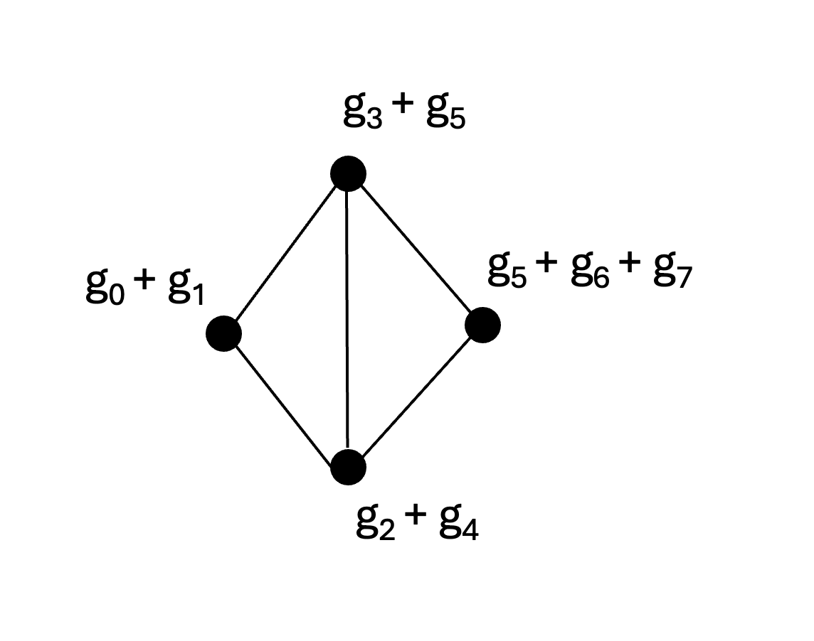
Relational sign audit
Given my knowledge of the model, is the relation I care about TRUE?
The server sent me one compressed update for the whole model.
Does it respect the parts of my model I know are tied together?

Slide 50
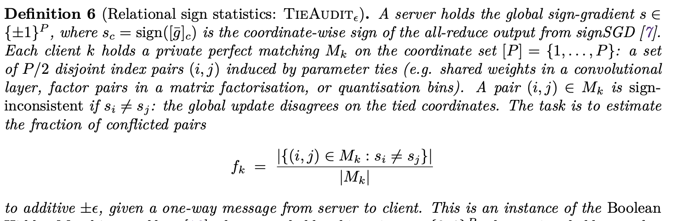
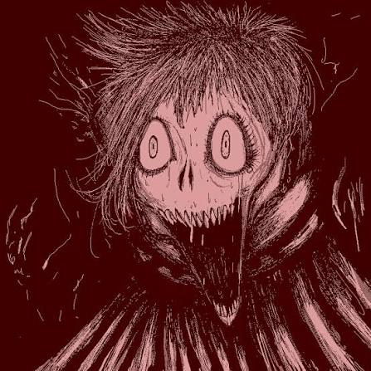

Relational sign audit
Given my knowledge of the model, is the relation I care about TRUE?
Compress our model
The server sent me one compressed update for the whole model.
Does it respect the parts of my model I know are tied together?

Slide 51
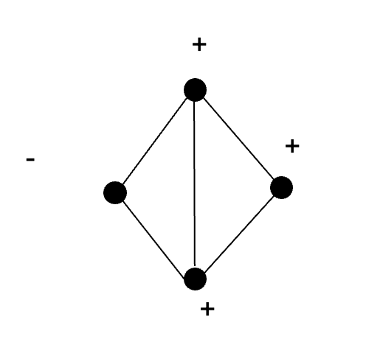
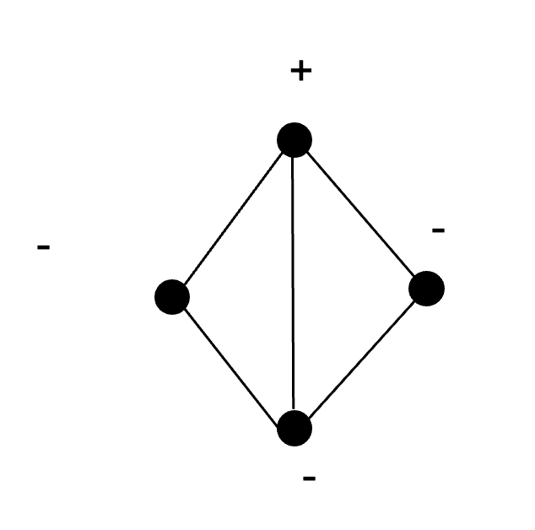


Relational sign audit
I KNOW
some gradient pairs should be “pushed” in the same direction (sᵢ = sⱼ).
I WANT TO CHECK
consistency of received information with my prior knowledge
Instance of Boolean Hidden Matching ☺

Slide 52
Relational sign audit
CLASSICAL
The server's message is fixed before it learns the client's matching.
To answer for whatever pairing the client privately holds, the message would have to preserve the parity sᵢ⊕sⱼ of an arbitrary pair.
Boolean Hidden Matching lower bound tell us the server is forced to send Ω(√P) bits (for the P² possible pairs), no matter how loose an answer (large ε) the client would accept.
Classically the server must answer every possible pairing in advance, which costs √P.

Slide 53

Relational sign audit
CLASSICAL
QUANTUM
Boolean Hidden Matching:
Ω(√P)
Notes:
The server sends a compressed update — just the sign of each parameter (up or down). The client knows which parameters its model ties together, and wants to check: does the update push tied pairs the same way, or pull them apart?
Classically, the server's message is fixed before it knows which pairs the client will ask about — and with ~P² possible pairs, no summary shorter than √P can answer for whatever pairing the client holds. (That's the Boolean Hidden Matching bound.)
Quantum: the server packs all P signs into one tiny state (log P qubits). The client measures it in the basis of its own tied pairs — and each measurement lands on one random pair and reveals whether it agrees or disagrees, exactly. The client's choice of measurement is the question; the server never had to anticipate it.

Slide 54
Relational sign audit
ε = the additive accuracy on the conflict fraction fₖ
QUANTUM
Each parameter's sign is written onto the amplitude of its own basis state |c⟩
SERVER
+ - + - - + - + + +…
|s⟩
phase state |s⟩ = (1/√P)·Σ s_{ᶜ}|c⟩
log P qubits
Notes:
The server sends the phase state |s⟩ = (1/√P)·Σ sᶜ|c⟩ — a single ⌈log₂P⌉-qubit register that carries all P sign bits at oncein its amplitudes.
The client measures each copy in the basis matched to its own tied pairs: {(|i⟩+|j⟩)/√2, (|i⟩−|j⟩)/√2}.
The magic is that the measurement collapses onto a random tied pair (i,j) and reads its parity with zero error — if sᵢ≠sⱼ the "agree" amplitude is exactly zero, because sᵢ|i⟩+sⱼ|j⟩ is orthogonal to |i⟩+|j⟩.
So one copy = one tied pair's verdict; averaging O(ε⁻²) copies gives the conflict fraction to ±ε. The client's choice of measurement basis is what extracts the relevant pair — no need to anticipate it at encoding time, which is exactly what classical can't do.

Slide 55
Relational sign audit
ε = the additive accuracy on the conflict fraction fₖ
QUANTUM
|s⟩
SERVER
pair-basis (parity) measurement
measurement lands on a random pair and returns + or − (agree or disagree)
Notes:
The server sends the phase state |s⟩ = (1/√P)·Σ sᶜ|c⟩ — a single ⌈log₂P⌉-qubit register that carries all P sign bits at oncein its amplitudes.
The client measures each copy in the basis matched to its own tied pairs: {(|i⟩+|j⟩)/√2, (|i⟩−|j⟩)/√2}.
The magic is that the measurement collapses onto a random tied pair (i,j) and reads its parity with zero error — if sᵢ≠sⱼ the "agree" amplitude is exactly zero, because sᵢ|i⟩+sⱼ|j⟩ is orthogonal to |i⟩+|j⟩.
So one copy = one tied pair's verdict; averaging O(ε⁻²) copies gives the conflict fraction to ±ε. The client's choice of measurement basis is what extracts the relevant pair — no need to anticipate it at encoding time, which is exactly what classical can't do.

Slide 56
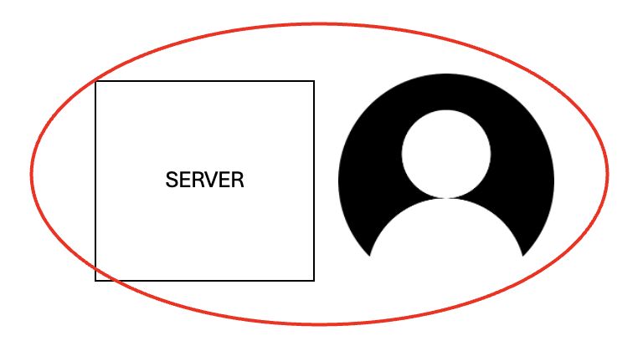
Relational sign audit
ε = the additive accuracy on the conflict fraction fₖ
QUANTUM
Repeat averaging O(ε⁻²) copies gives the conflict fraction to ±ε
Quantumly the server sends one state holding all the signs, and the client's measurement picks out the pair it cares about.
Notes:
The server sends the phase state |s⟩ = (1/√P)·Σ sᶜ|c⟩ — a single ⌈log₂P⌉-qubit register that carries all P sign bits at oncein its amplitudes.
The client measures each copy in the basis matched to its own tied pairs: {(|i⟩+|j⟩)/√2, (|i⟩−|j⟩)/√2}.
The magic is that the measurement collapses onto a random tied pair (i,j) and reads its parity with zero error — if sᵢ≠sⱼ the "agree" amplitude is exactly zero, because sᵢ|i⟩+sⱼ|j⟩ is orthogonal to |i⟩+|j⟩.
So one copy = one tied pair's verdict; averaging O(ε⁻²) copies gives the conflict fraction to ±ε. The client's choice of measurement basis is what extracts the relevant pair — no need to anticipate it at encoding time, which is exactly what classical can't do.

Slide 57
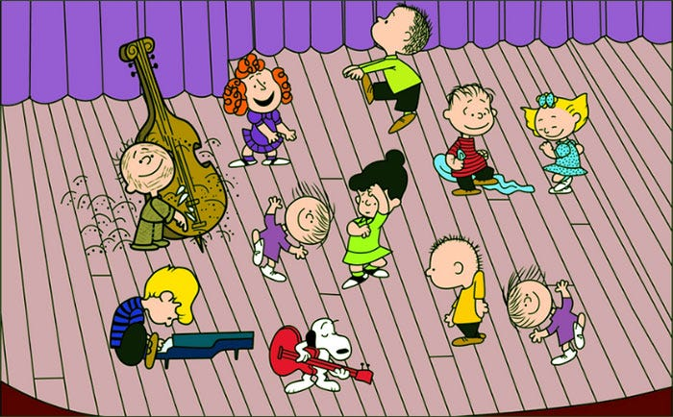
Relational sign audit
ε = the additive accuracy on the conflict fraction fₖ
Classical holds regardless of ε
CLASSICAL
QUANTUM
Ω(√P) bits
One way
O(ε⁻²·log P) qubits
One way

Slide 58
Conclusions
We got some modest reductions and some nice free security on one of the main communication primitives used today for large scale ML training.
We found a set of related problems which offer quantum advantage and point to complexity landscapes where the certification and evaluation of relational properties could point to quantum advantages.
USEFUL! but boring for quantum people
INTERESTING! but useful?
Cheaper coordination (+ free privacy) in distributed ML
+
New pointers to quantum advantage for distributed problems

Slide 59

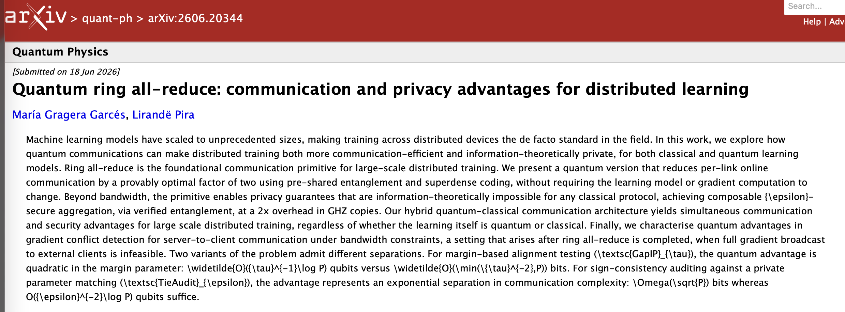
Check out the paper!
& perhaps see you at QTML

Slide 60
g₁
g₃
g₅
g₀
g₇
g₂
g₄
g₆

Slide 61
g₃ + g₅
g₀ + g₁
g₅ + g₆ + g₇
g₂ + g₄

Slide 62
+
-
-
-

